Slide 1

Automatic Text Summarization
Group 5
final results

Slide 2
Content
Situation
Task
Action
Result

Slide 3
Situation

Slide 4
multi document summarazation
Situation
Task
Action
Result
sth about related work and whats going on in multi document summarization

Slide 5
Task

Slide 6
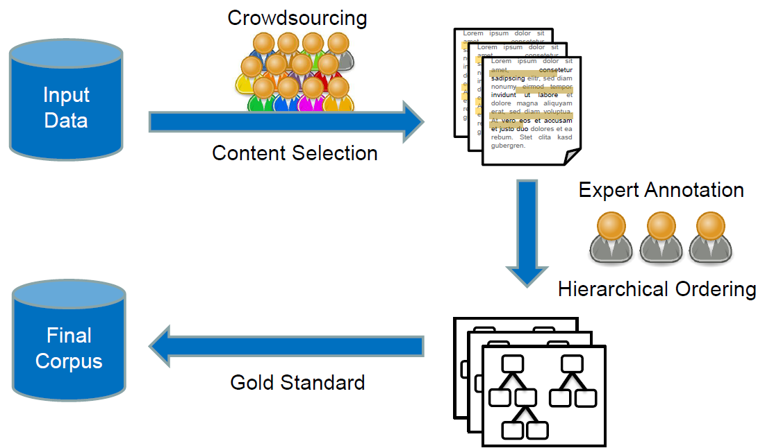
hierarchical approach
Situation
Task
Action
Result

Slide 7
Action

Slide 8
Step 1 – Content Selection – Data Analysis
Situation
Task
Action
Result
Nugget ratios – Approximately TODO% nuggets per topic
Nugget structure – TODO% whole sentences
No words, that occur primarily in nuggets or non nuggets

Slide 9
Step 1 – Content Selection – General Idea
Situation
Task
Action
Result
Approach: Learn a classifier to recognize nuggets
Use training binary labeled training data from all 10 given topics
They now have 300 Associate Offices in 25 countries. 0
ATTEND takes about 30-60 days to become effective. 1
Get up early in the morning. 0
…
Labeled Data
Diet is often part of the problem. 1
…

Slide 10
Step 1 – Content Selection – Approaches
Situation
Task
Action
Result
FastText classifier
Naive Bayes
Fully Connected Neural Network
Convolutional Neural Network

Slide 11
Step 1 – Content Selection – Results
Situation
Task
Action
Result
FastText classifier - Bad
Naive Bayes - Bad
Fully Connected Neural Network - Bad
Convolutional Neural Network - Okay

Slide 12
Step 1 – Content Selection – Convolutional Neural Network - Preprocessing
Situation
Task
Action
Result
Preprocess with gensim simple preprocess Allow only sentences between 5 and 50 words, pad them to 50 words
„I don‘t know. U.S. History II Attendance and tardies! All School Assemblies“ – good to read?
Negative Example
I don't know.
U.S. History II
Attendance and tardies!
All-School Assemblies

Slide 13
Step 1 – Content Selection – Convolutional Neural Network – Architecture
Situation
Task
Action
Result
Input sentences as average word embedding (Bag of Words) 300 embedding dimensions
Random Search with early stopping to find good Parameters
Criteria:
Recall > 0.05 Precision as high as possible
Data split into 3 sets: Training, Development, Testing
Implementation with Keras. Computation on Lichtenberg Cluster

Slide 14
Step 1 – Content Selection – Convolutional Neural Network – Architecture
Situation
Task
Action
Result
Parametername | Possible Range | Final Params
Batch size | [120, 180] | 150
number of convolutional layers | [1,2] | 2
filter sizes per layer | [30, 60] | 6, 6
Number of filters per layer | [4, 7] | 47, 42
Optimizer | [adam, sgd, adagrad] | Adagrad

Slide 15
Step 1 – Content Selection – Convolutional Neural Network – Results
Situation
Task
Action
Result
Precision = 52%
Recall = 5.9%
Instead of using all predicted data, we used the 30 sentences with the highest nugget probability score
[Using tf-idf weighting of words lead to terrible results] – woanders hinschieben

Slide 16
Step 2 generate hierachies from nuggets
Situation
Task
Action
Result
aim: insert nuggets into bubble → build tree
used: compare two nuggets
if new bubble then use which function to determine the right bubble or create new
else insert in existing bubble
prelimitaries:
handle nuggets, remove stops and stem

Slide 17
Step 2 insert function
Situation
Task
Action
Result
initial situation
new nugget
UP
INSERT
DOWN

Slide 18
Step 2 compare and which function
Situation
Task
Action
Result
which()
use nltk_path_similarity to choose subtree
index of subtree
compare()
compare TF-IDF with
return similar (INSERT), general (UP), or specific (DOWN)

Slide 19
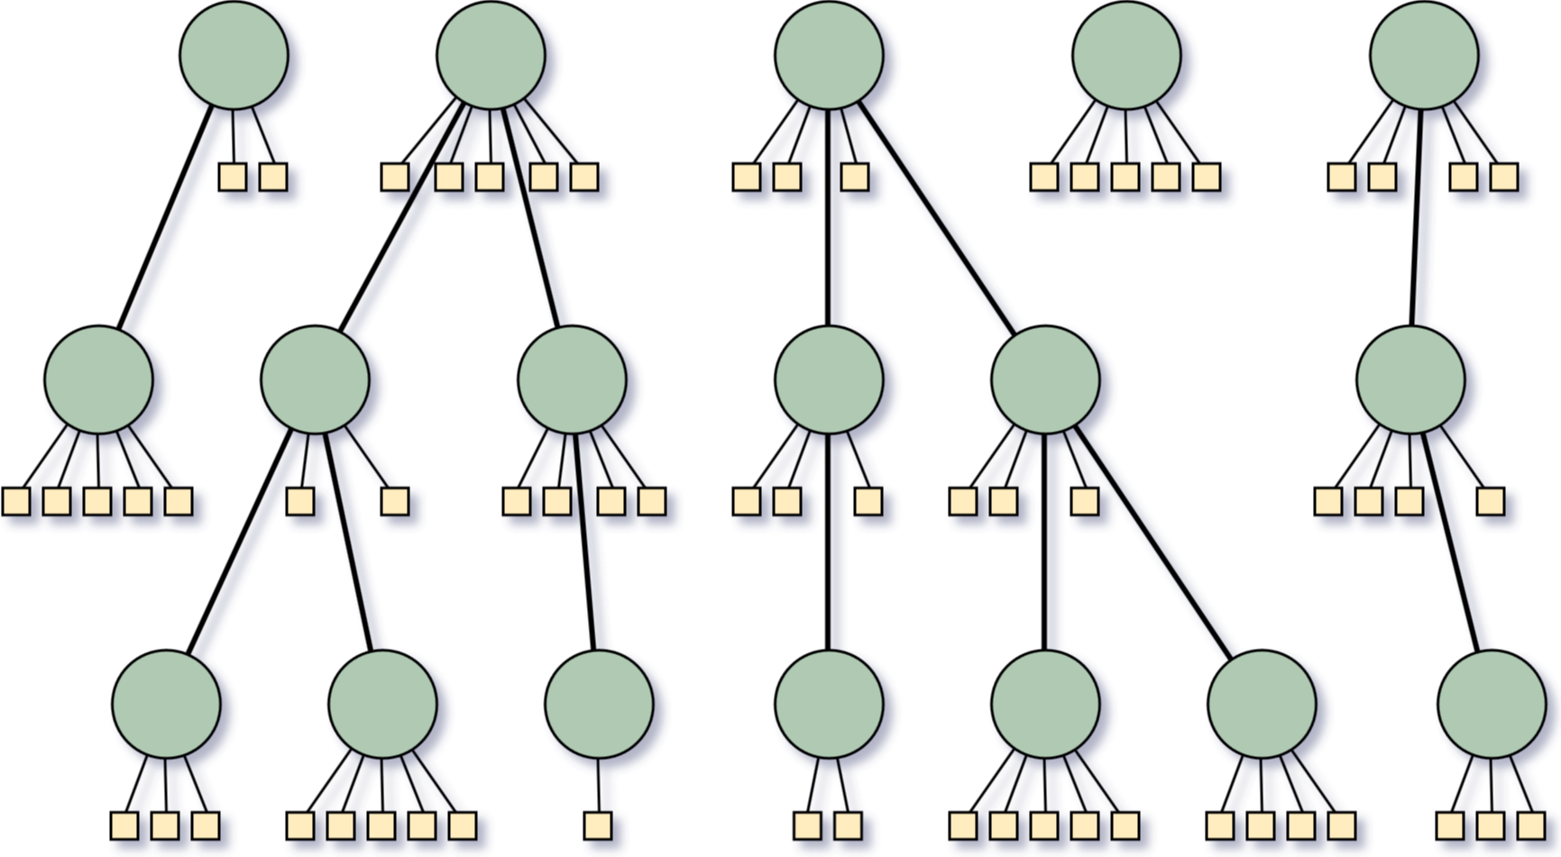
Step 3 – Creating summaries from hierarchies
Situation
Task
Action
Result

Slide 20
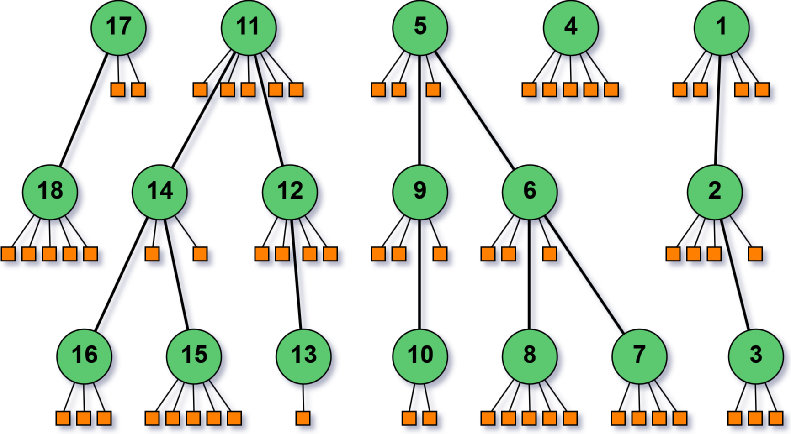
Step 3 – Creating summaries from hierarchies
Situation
Task
Action
Result
first approach: Iterate in depth-first search order over the nuggets

Slide 21
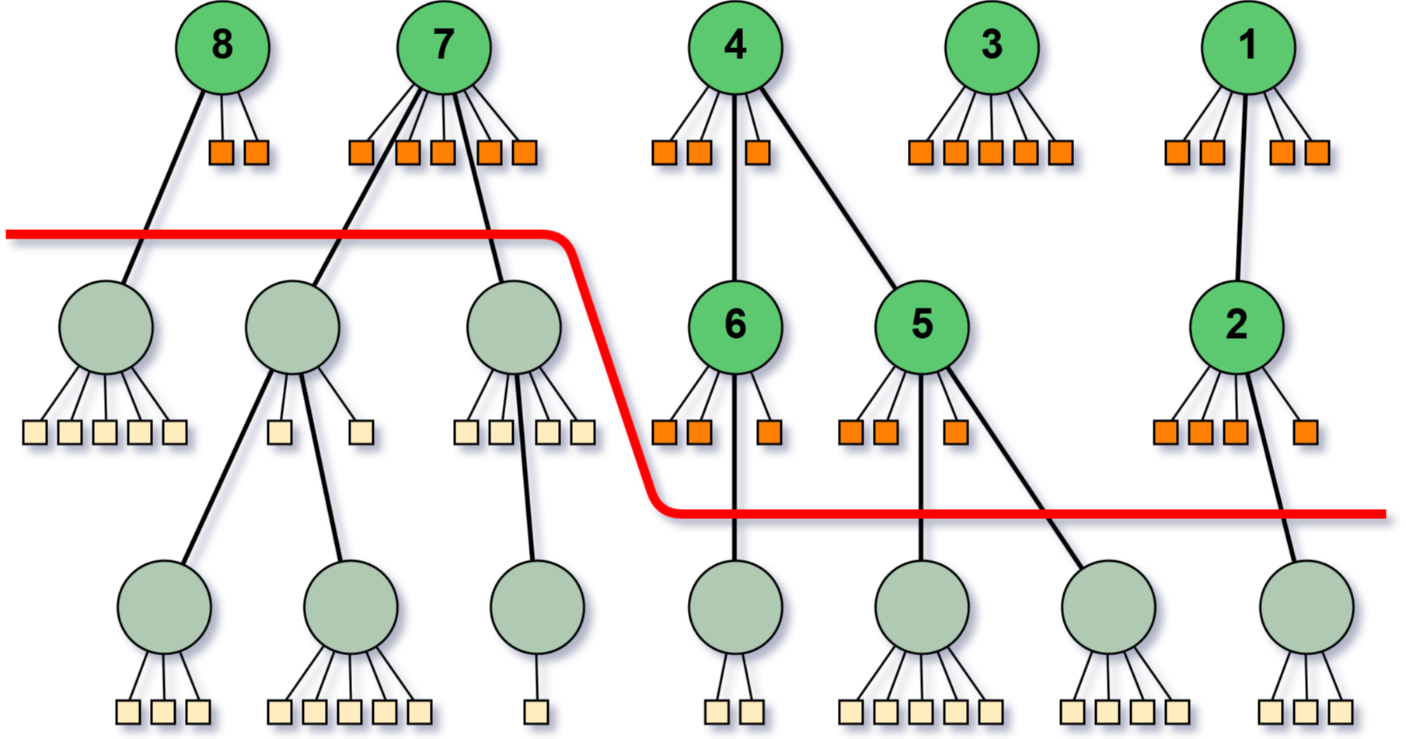
Step 3 – Creating summaries from hierarchies
Situation
Task
Action
Result
cut layers off to get shorter summaries

Slide 22
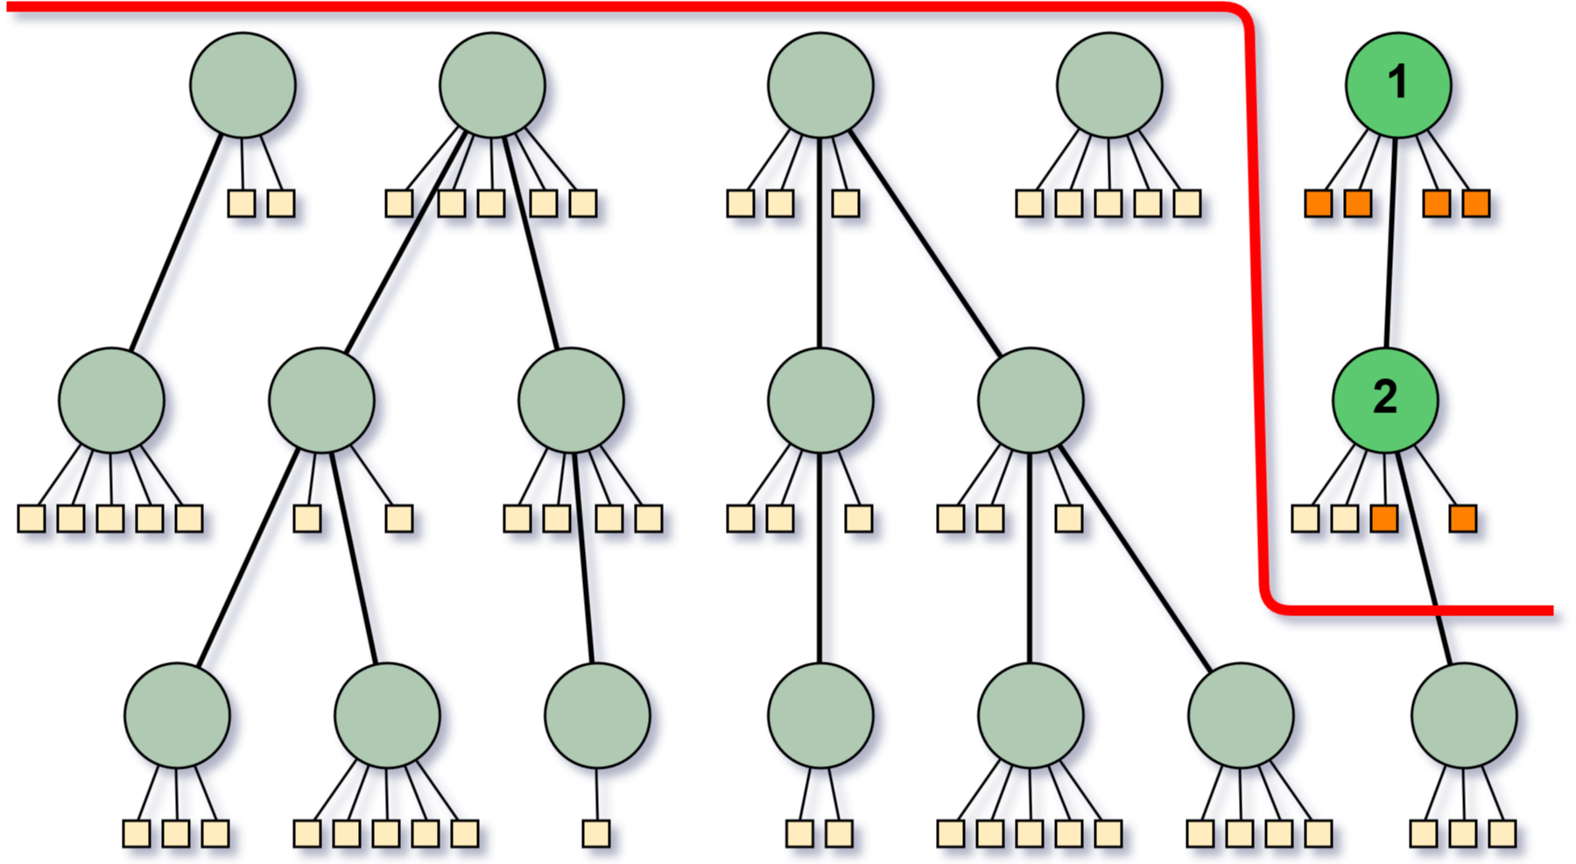
Step 3 – Creating summaries from hierarchies
Situation
Task
Action
Result
problem when summaries are very short

Slide 23
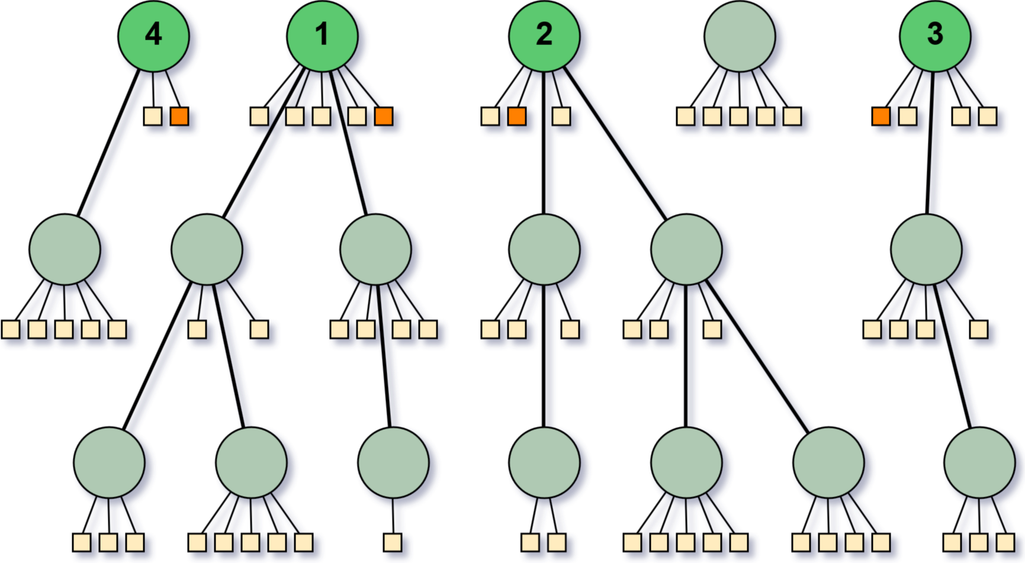
Step 3 – Creating summaries from hierarchies
Situation
Task
Action
Result
select shortest sentences from root bubbles of the largest trees

Slide 24
Step 3 – Creating summaries from hierarchies
Situation
Task
Action
Result

Slide 25
Result

Slide 26
evaluation
Situation
Task
Action
Result
each of our summaries were evaluated by at least 4 raters

Slide 27
Thank You for your attention

